Slide 1
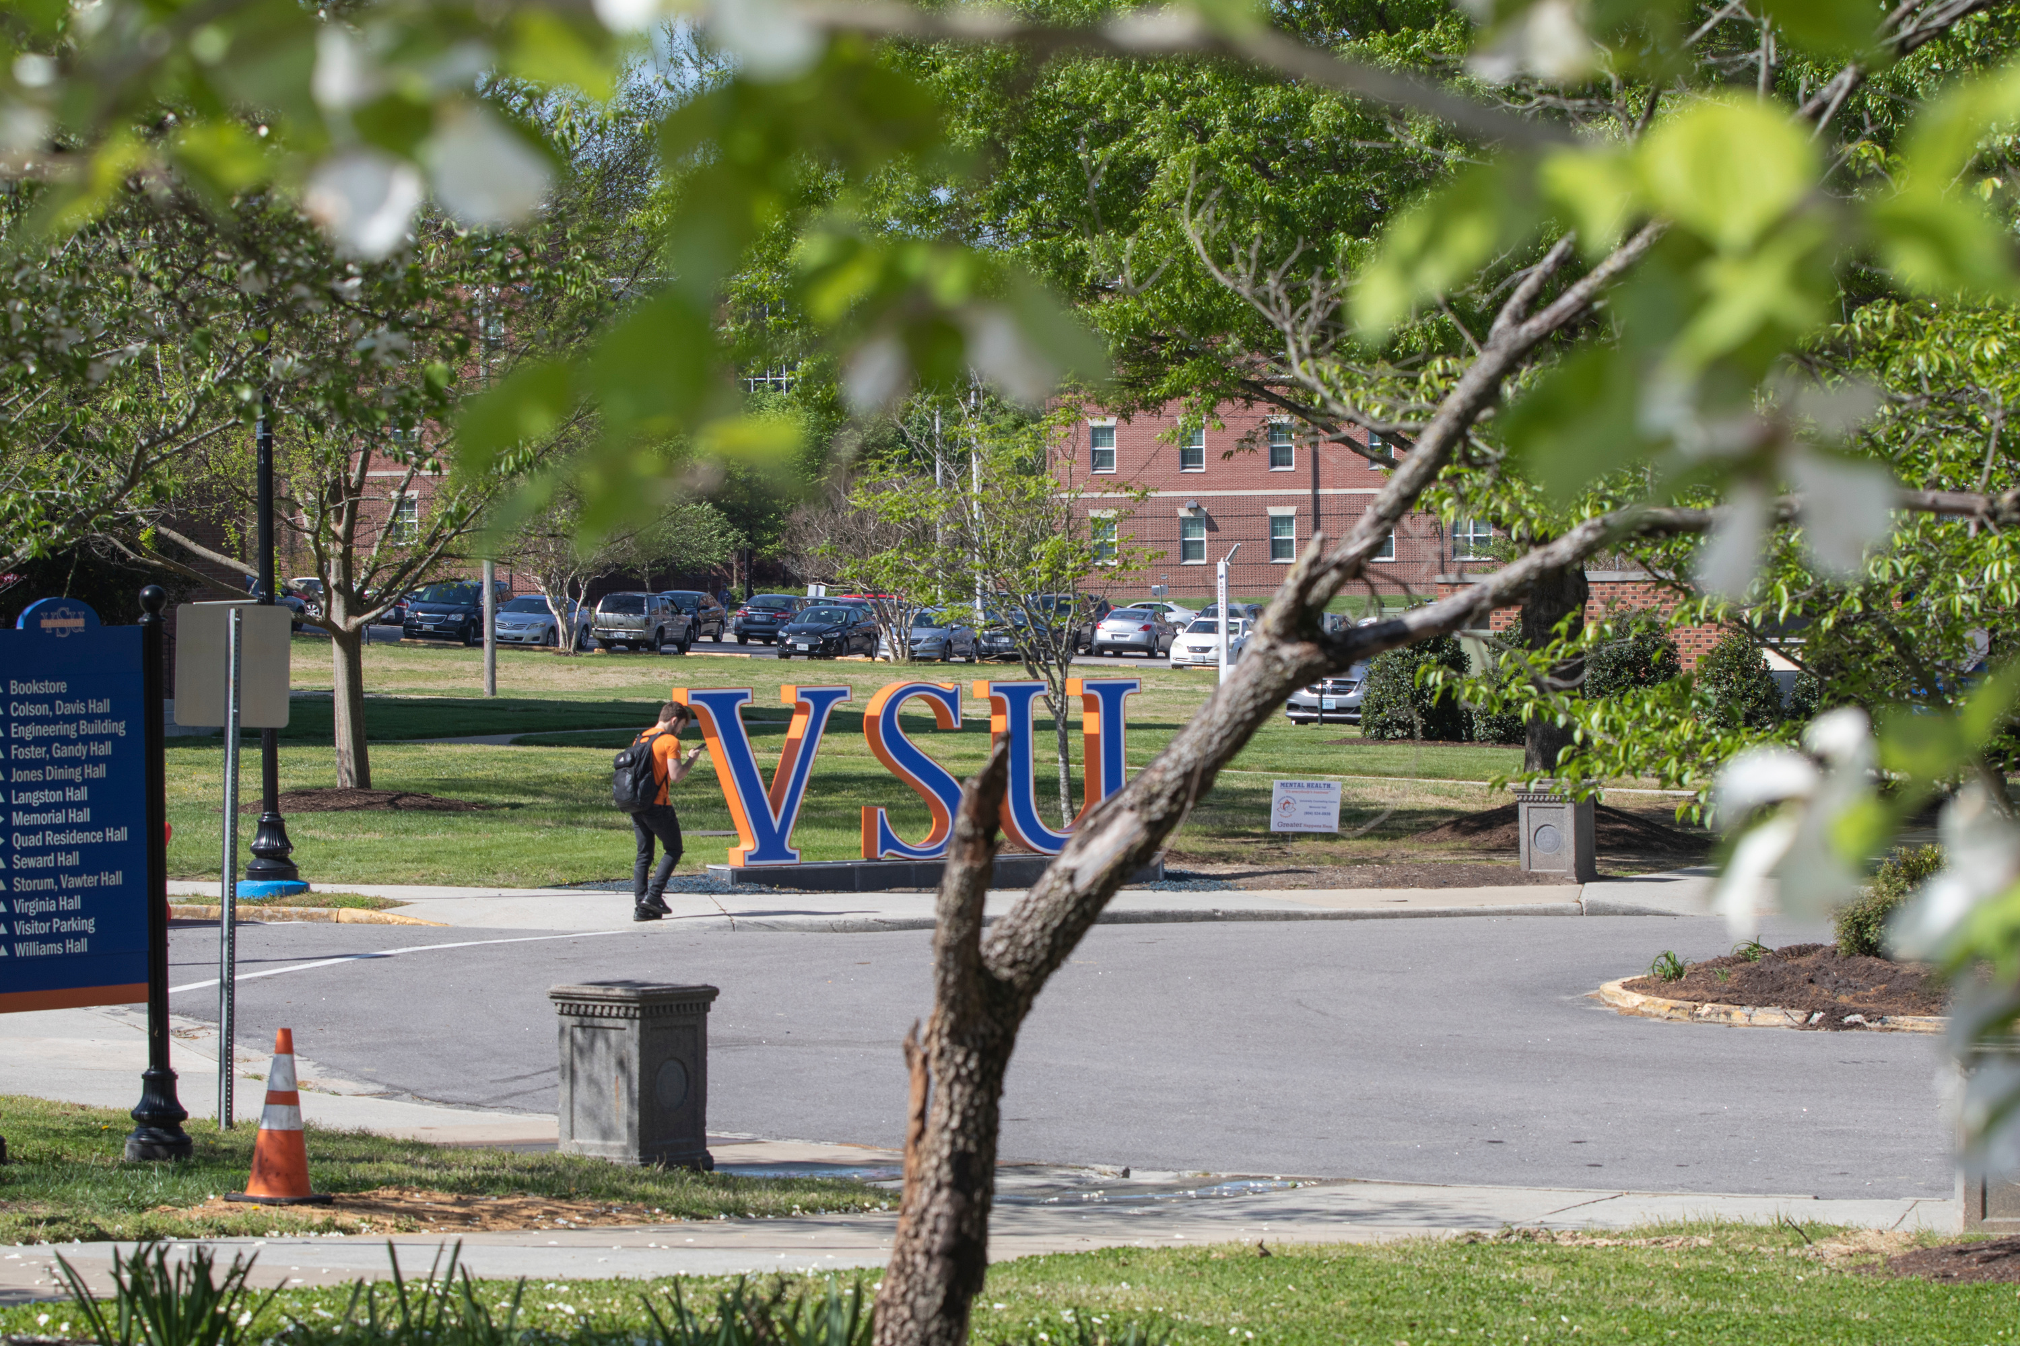






Virginia State University
Board of Visitors
Academic Affairs & Student Affairs Committee
September 11, 2025

Slide 2
Committee Agenda
Academic Affairs Updates
Dr. Tia A. Minnis
Provost and Vice President for Academic Affairs
Enrollment Updates
Dr. Alexis Brooks-Walter
Vice President for Student Affairs and Enrollment Management
Safety and Security Update
Chief David Bragg
AVP for Safety and Security
Student Engagement Update
Ms. Regina Barnett-Tyler
AVP for Student Success & Engagement

Slide 3
September 11, 2025
DIVISION OF
Academic Affairs
Tia A. Minnis | Provost & Vice President for Academic Affairs

Slide 4

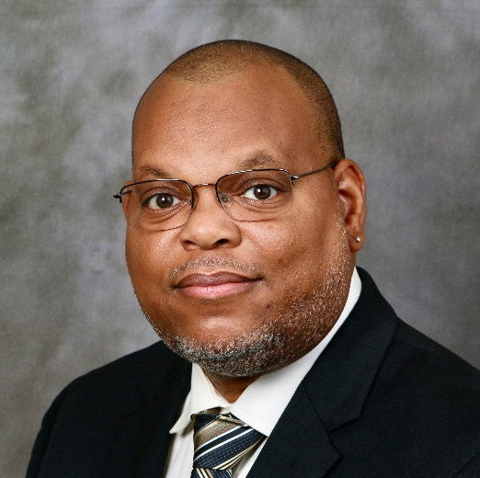
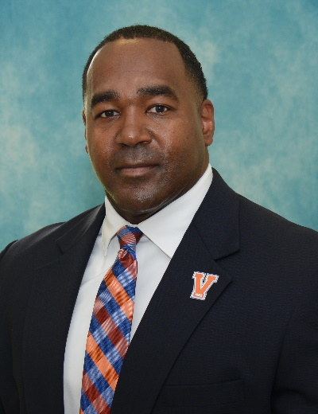
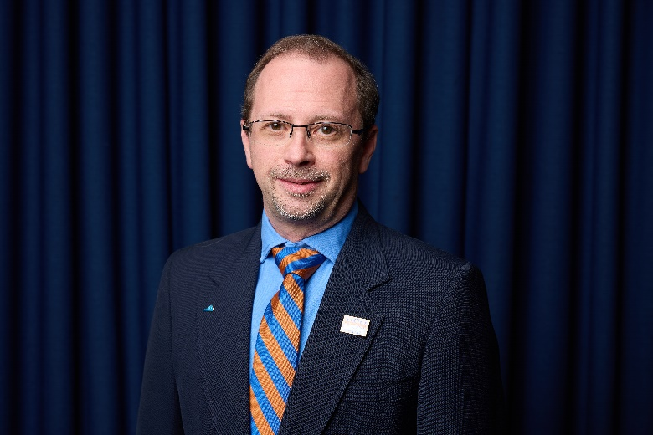

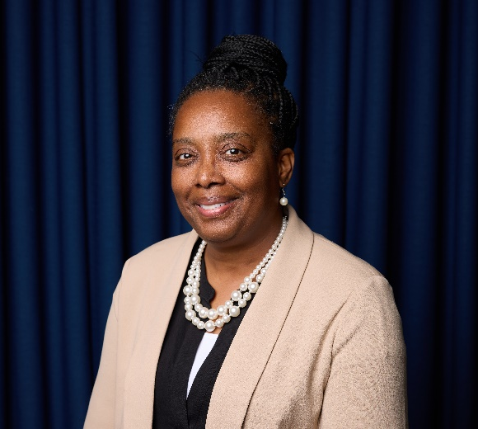


Academic Affairs New Team Members
Dr. Desmond Stephens
Lt. Col. (ret.) Forrest Black
Dr. Brian Sayre
Vice Provost
Academic Affairs
Exec. Director for Distance Education & Professional Studies
Academic Affairs
Director for Academic & Operational AI Integration
Academic Affairs
Dr. Michelle Mosely
Dr. Sharon Lassiter
Director of General Education & Faculty Excellence
Academic Affairs
Director of DE, Online Leaning, & Offsite Educational Programs
Academic Affairs

Slide 5
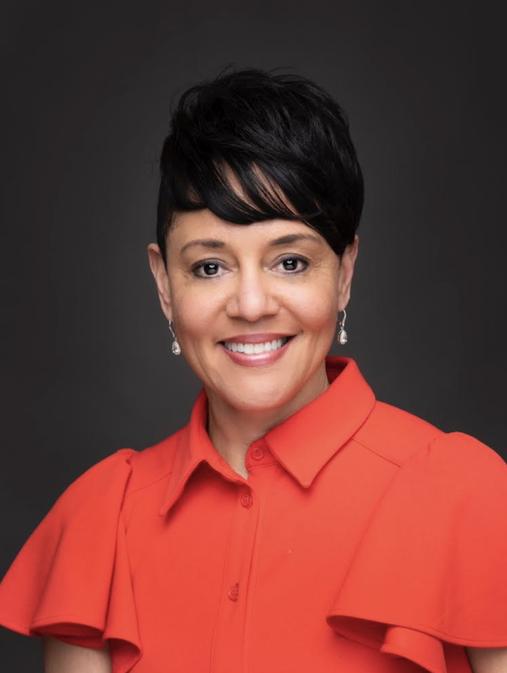
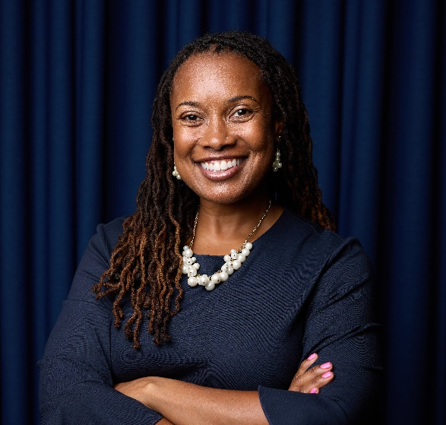
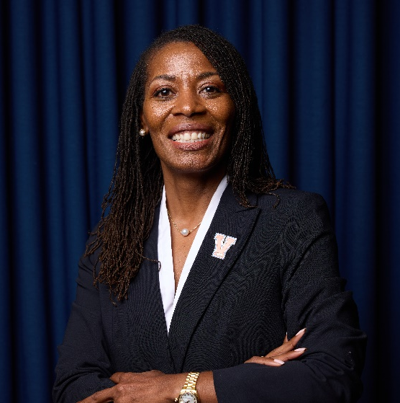
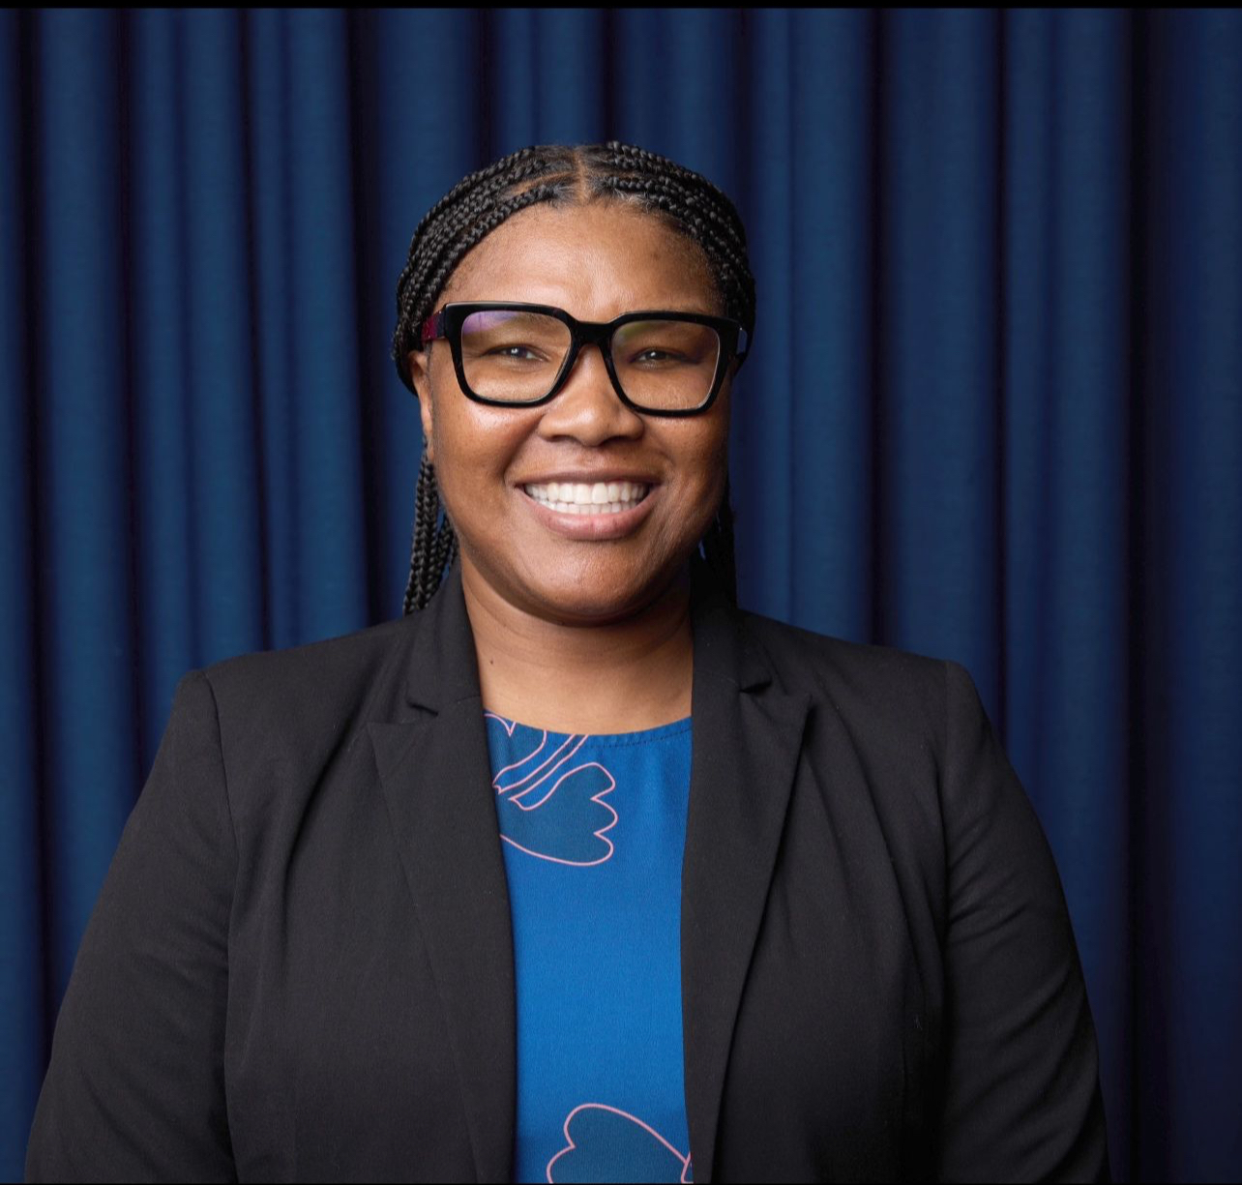
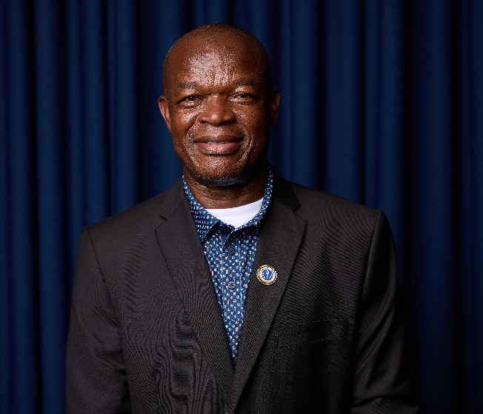
Academic Affairs New Team Members
Dr. Jewel Bronaugh
Dr. Kristal M. Clemons
Dr. Jessica Brooks
Dr. Lachelle Waller
Interim Dean
College of Agriculture
Interim Assoc. Dean
College of Education
Interim Dean
College of Natural & Health Sciences
Interim Assoc. Dean
College of Natural & Health Sciences
Dr. Benedict Uzochukwu
Interim Dean
College of Graduate Studies

Slide 6

Academic Affairs Initiatives
Career-Ready and Workforce-Aligned Graduates
Degree+ Initiative
Ensure Every Graduate Earns a Value-Added Credential
Certificates, Micro-Credentials, Second Degree, Accelerated Grad Degrees
TrojansWork Initiative
Advancing Experiential Learning & Workforce Development
Preparing Students for Meaningful Careers and Lifelong Success

Slide 7

TrojansWork Initiative
Purpose
Ensure every undergraduate graduates with relevant, real-world work experience
Embed paid, career-focused experiential learning opportunities
Integrate workforce readiness and applied learning into academic programs
Advance economic mobility through career pathways

Slide 8






TrojansWork Initiative
Current Programs of Interest
Engaging Learning Award for Honors (ELAH): Service-learning Stipends
TrojansWork Campus Jobs: Purposeful On-Campus Employment
Human Resources
Budget and Finance
Information Technology
Student Accounts
Financial Aid
Procurement
Agriculture, Research, and Extension
University Library
Institutional Research

Slide 9
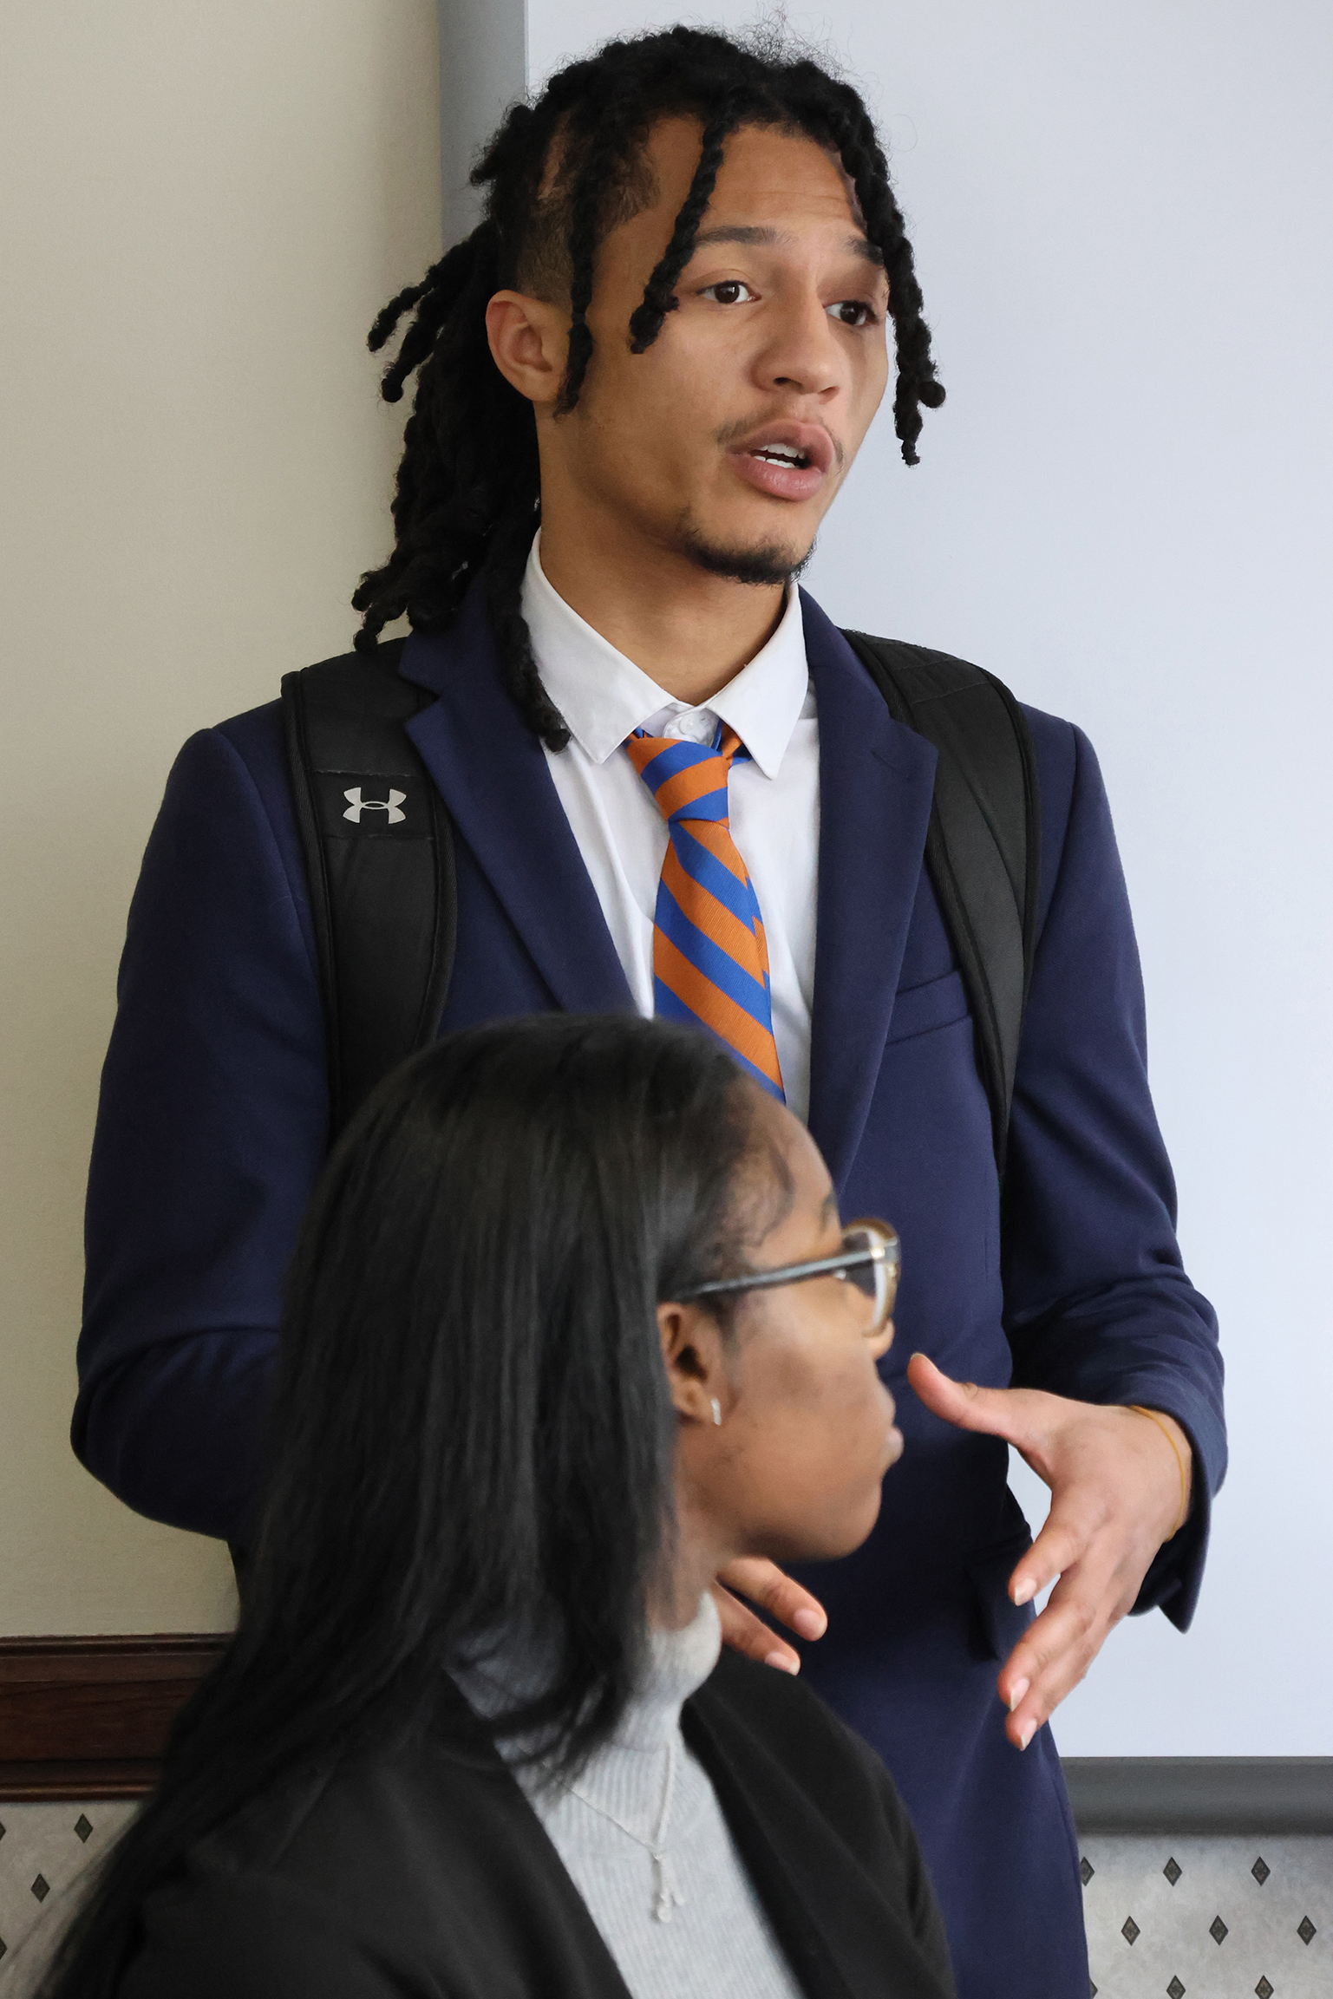

TrojansWork Initiative
Current Programs of Interest
Virginia TOP: Connects Students to Statewide Opportunities
Vision & Capacity Grant: Award $250,000 for workforce education and capacity-building initiatives
VSU Career Services & Handshake: Employer Partnerships & Tracking

Slide 10
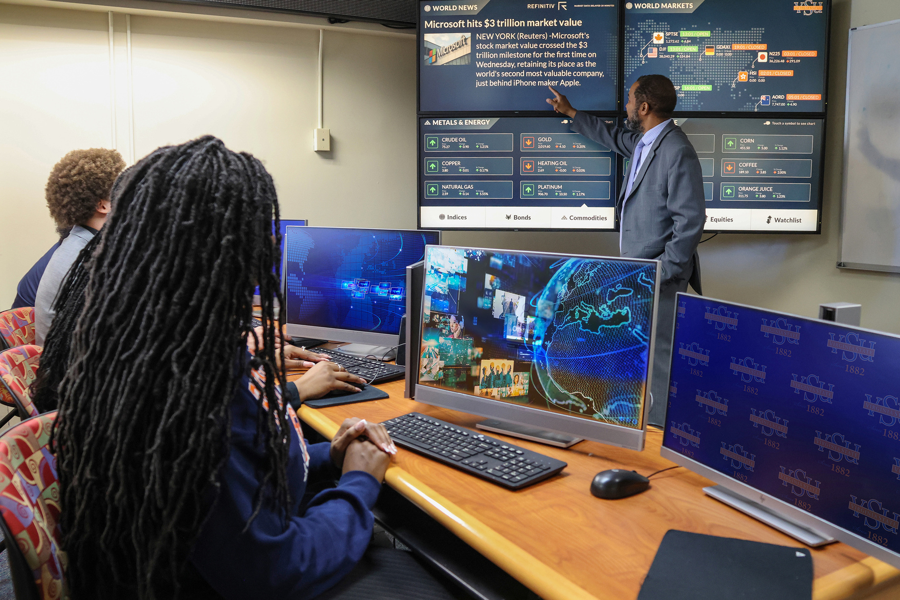
TrojansWork Initiative
Workforce Development Partnerships
IBM SkillsBuild
Advancing Skills
Free Micro-Credential (AI, Cybersecurity, Data Analytics)
Direct Career Opportunities
Paid Micro-Internships
Mentoring
Student Mentoring with IBM Professionals
Access to Exclusive Events
HBCU Student Tech Talk Wednesday
Monthly IBM Expert Lecture Series
Semi-Annual IBM Security Event

Slide 11
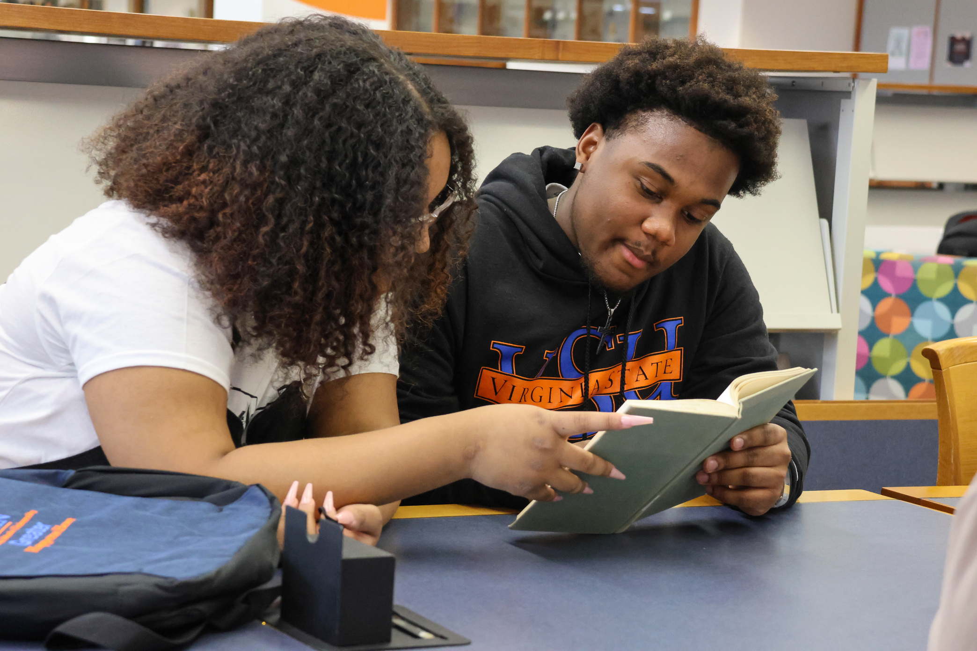
TrojansWork Initiative
Workforce Development Partnerships
Coursera: Free Training & Certifications for All Students
LinkedIn Learning: Professional & Technical Skill Development & Networking
MedCerts: Affordable Healthcare and Technology Certifications ($2K–$5K)

Slide 12

TrojansWork Initiative
MedCerts at VSU

Slide 13
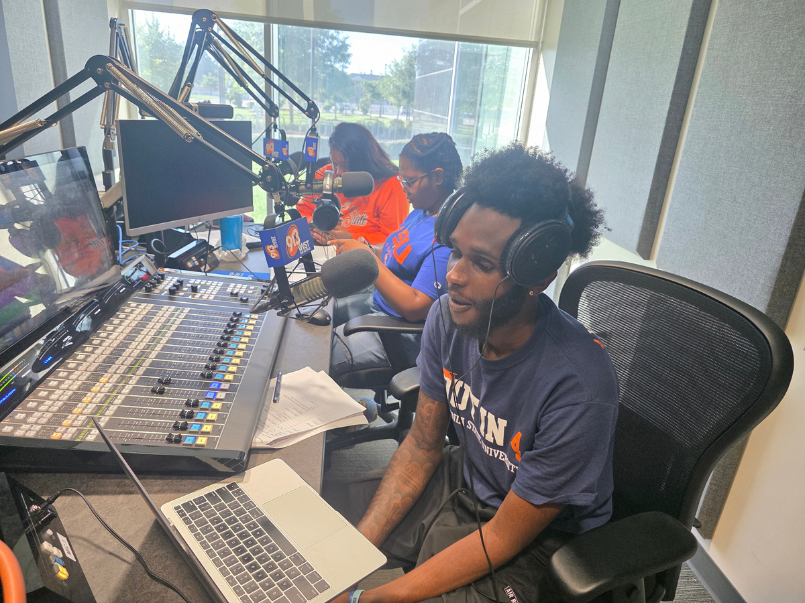
TrojansWork Initiative
TrojansWork Initiative
Barrier Removal Strategy
Connecting Student to Opportunities
Stipends for Unpaid Opportunities
Academic Flexibility: INDS 200/400 Credit-Bearing Options
Transportation Support
Professional Attire
Summer Housing
Tuition Assistance
Travel Assistance

Slide 14

TrojansWork Initiative
Proposed Framework
Expand Via Workforce Development Grant Funding
Scale Internships and Micro-Internships Across All Majors
Redefine Workforce Development (Support Service Learning, Project-Based Learning, Research, Study Abroad, etc.)
Embed Soft Skills Training throughout the Curriculum (Teamwork, Communication, Critical Thinking, etc.)
Greater Investment in Faculty Enrichment (Training and Development, Release Time, Microgrants)
Deepen Industry Partnerships

Slide 15
TrojansWork Initiative
Assessment and Outcomes
Employer Feedback & Supervisor Evaluations
Student Portfolios and Capstone Presentations
Student Experience Surveys (mentorship, culture, support, levels of preparedness, etc.)
Outcome Data:
Placement Tracking Data
Credential Attainment Data
Post-Graduation Employment Data

Slide 16
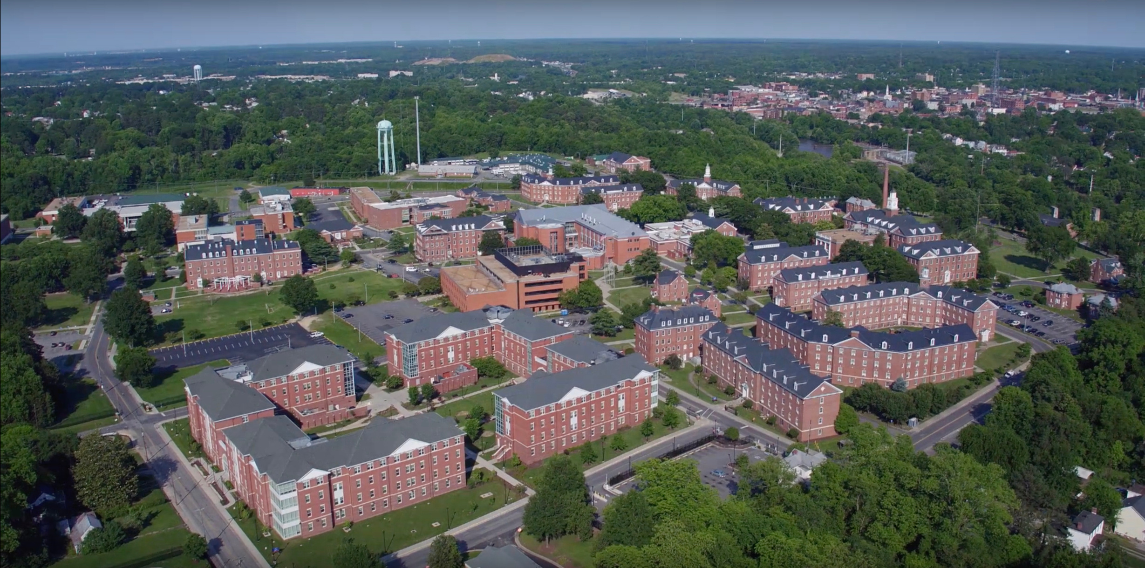
TrojansWork Initiative
Ultimate Goal
TrojansWork:
Transforms Career-Readiness at VSU
Ensure Every Undergraduate Completes One Paid, Career-Aligned Experience
Enhance Employability and Economic Mobility
Position VSU as a National Model for Barrier-Free Applied Learning

Slide 17
Alexis Brooks-Walter
Vice President of Student Affairs and Enrollment Management

Slide 18
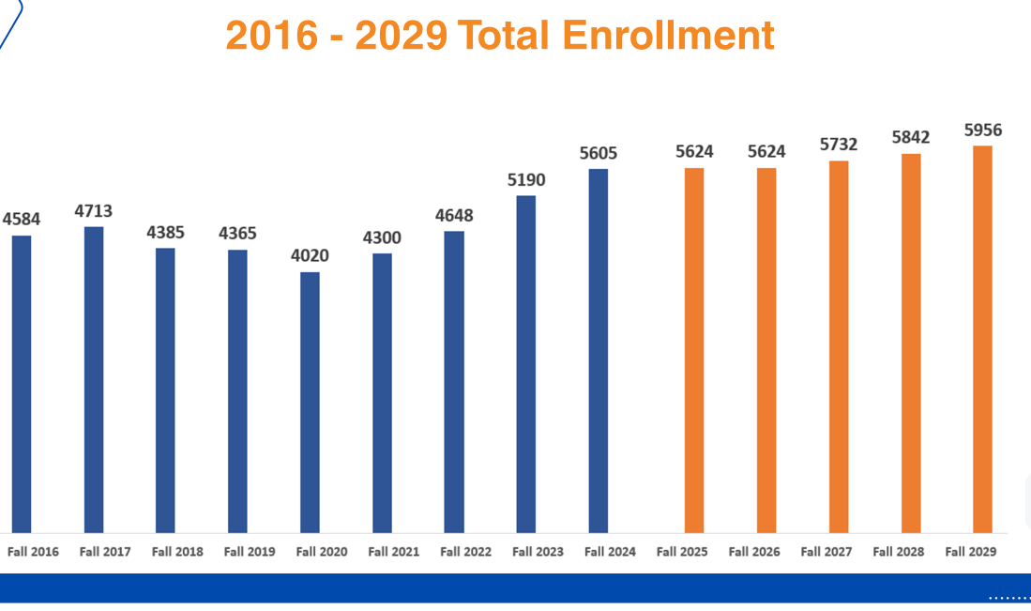
Enrollment Projections

Slide 19
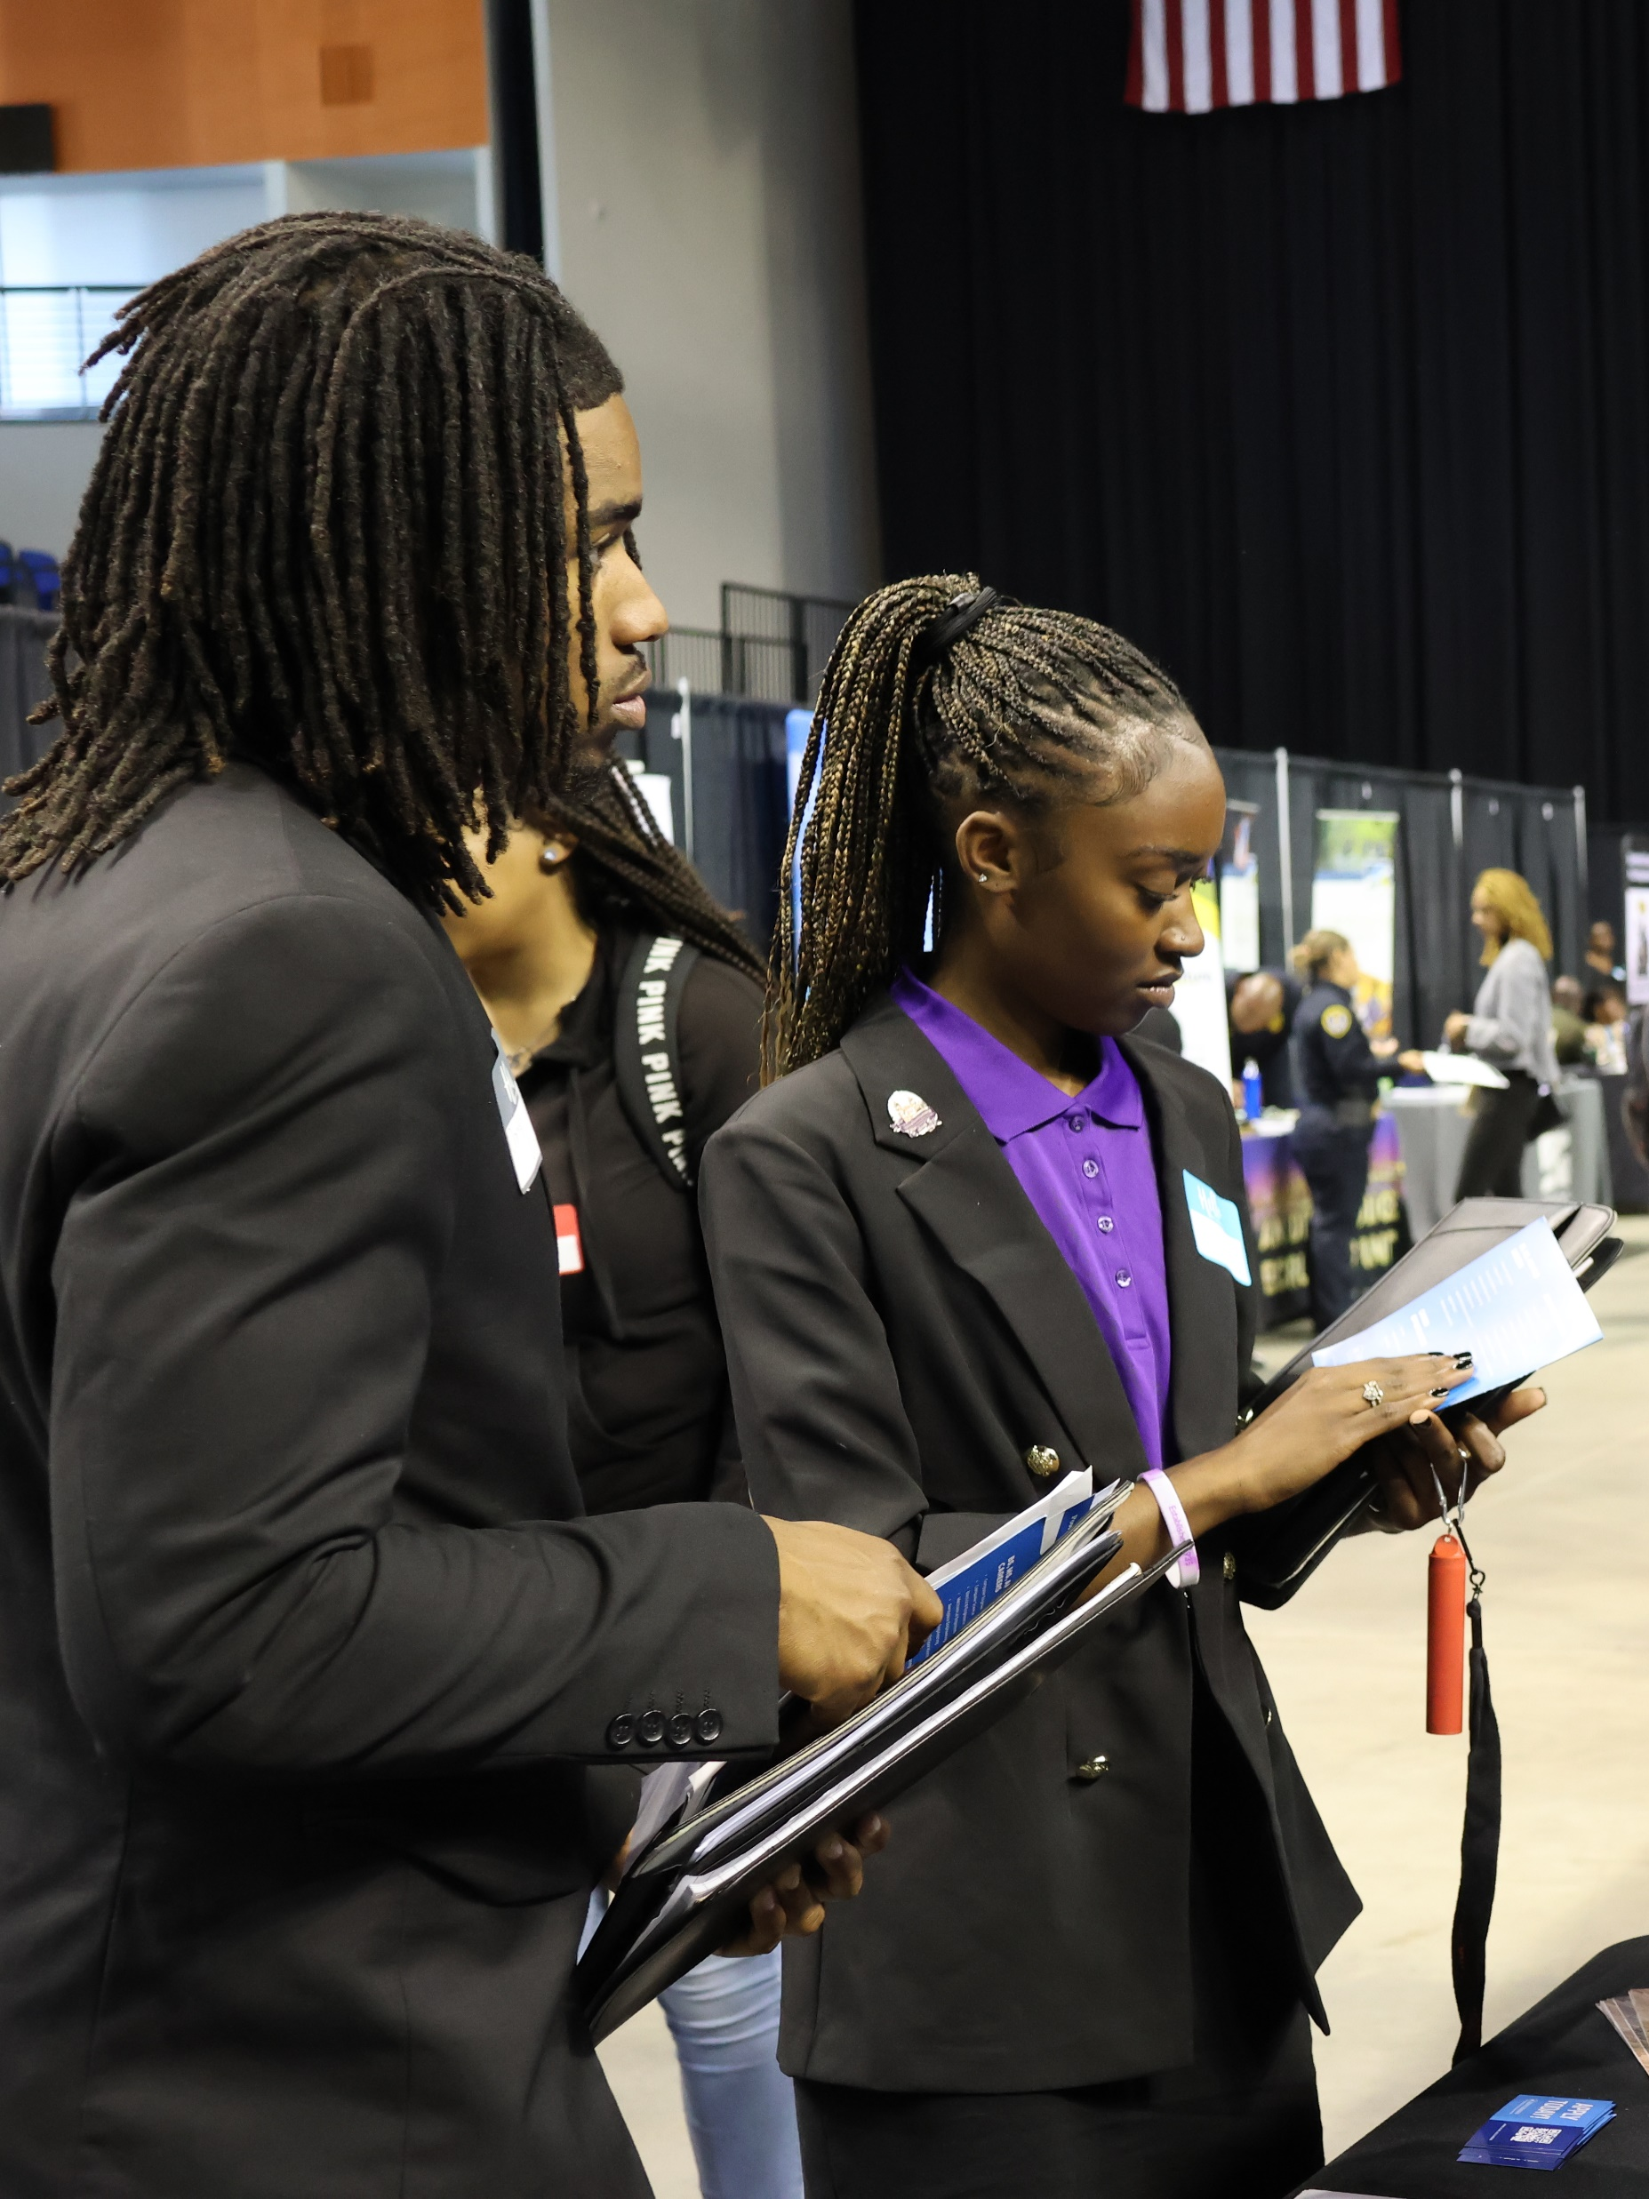
Factors Impacting Enrollment
Housing concerns
Revision to scholarship structure
New Admission Software
Personnel changes
Demographic shifts
Rising Costs and Student Debt

Slide 20
“Access without support is not opportunity.” Dr. Vincent Tinto Distinguished University Professor at Syracuse University

Slide 21
Regina Barnett-Tyler
Associate Vice President of Student Success and Engagement

Slide 22

Campus Ministries Career Services
Child Care Access Means Parents in Schools, (CCAMPIS)
Community Outreach & Engagement
Educational Opportunity Centers, (EOC) Educational Talent Search (ETS)
Greek Life Office on Violence Against Women, (ovw)
Residence Life & Housing Student Activities
Student Conduct Trojan Leadership Program, (TLP)
Student Support Service, (SSS) Upward Bound Program

Slide 23
SSE Grant Funded Programs
TRIO Programs
Educational Opportunity Centers , (EOC)
Educational Talent Search, (ETS)
Student Support Services, (SSS)
Upward Bound Program
Child Care Access Means Parents in Schools, (CCAMPIS)
*Commonwealth Savers/SOAR
Office on Violence Against Women, (OVW)

Slide 24

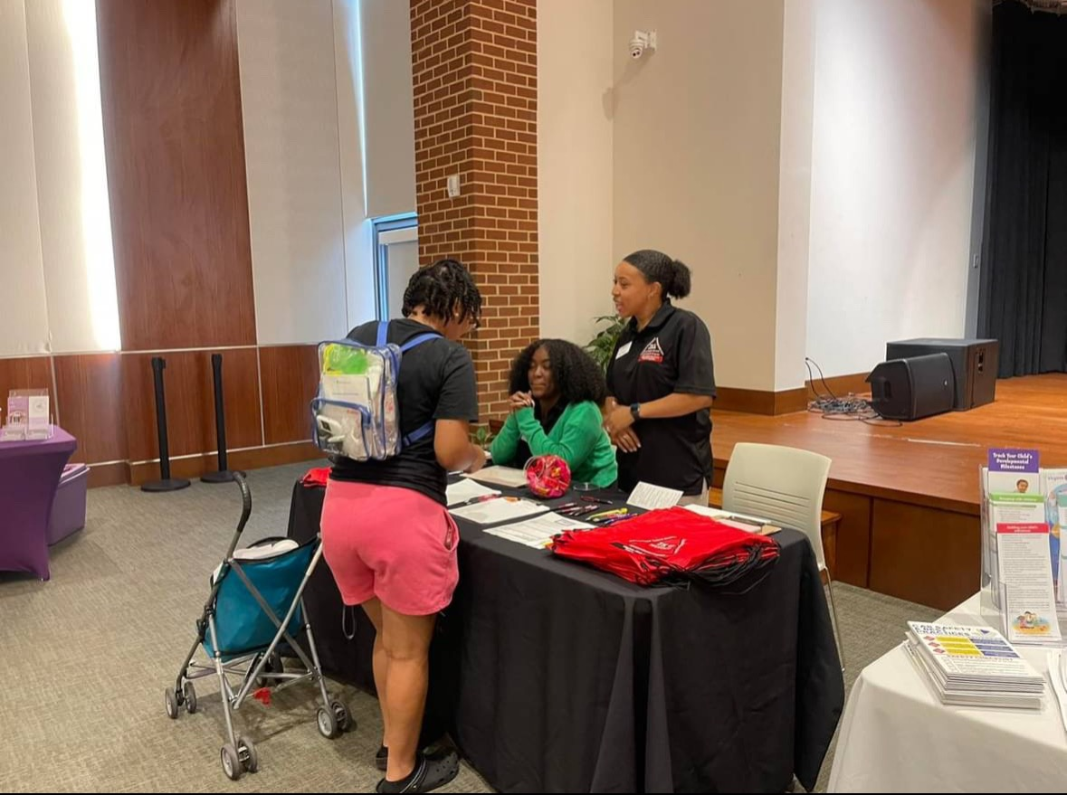
Upward Bound Program, (UBP) successfully
funded since in 1968; Serves 88 HS students
Marquis Mason
‘25-26 SGA President
VSU Upward Bound Alum
Petersburg HS alum
Educational Opportunity Centers (EOC)
funded since Sept. 2011; Serves 1000

Slide 25
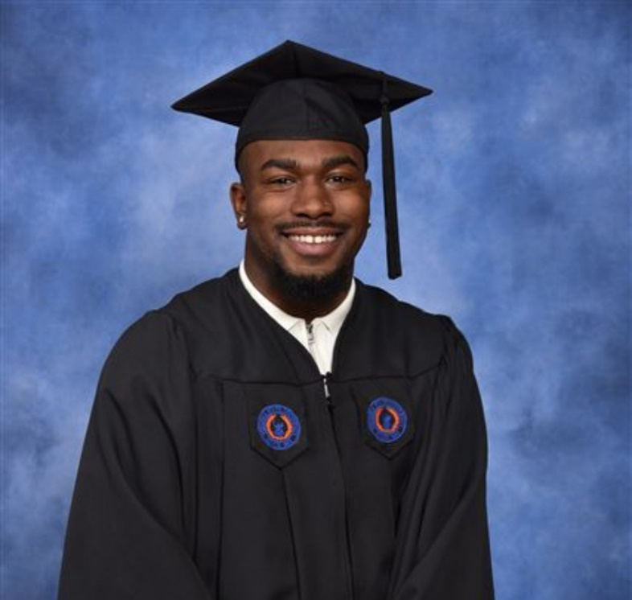
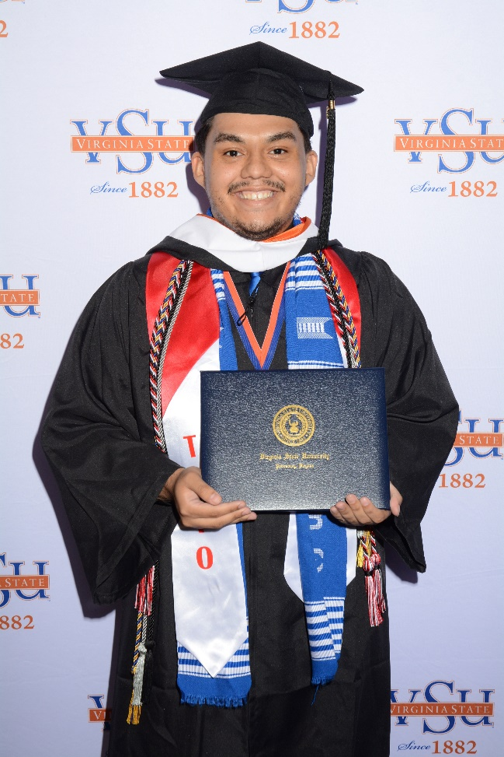
Isreal Watkins
Spr. 2025 VSU grad
Petersburg HS alum
Educational Talent Search Program, (ETS)
funded October 2016; Serves 500
Student Support Services, (SSS) Funded since Sept. 2020;
Serves 140 VSU students annually

Slide 26
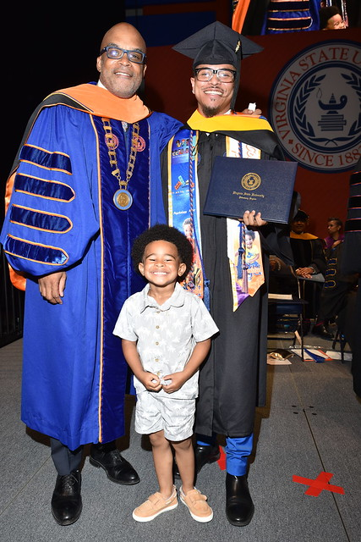
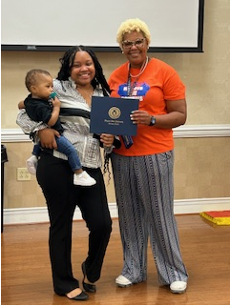
Child Care Access Means Parents in Schools, (CCAMPIS)
Child Care Access Means Parents in School, (CCAMPIS) Funded October 1, 2022
Currently serve 43 student parents who receive financial assistance for childcare;
14 student parents reside in university housing, (UAE);
8 are on the waiting list for housing
17 student parents are on the waitlist for available child care;
Drop Off Service this semester from 4 – 9:30 pm
for student parents who have evening classes; bills, gas etc.

Slide 27

Career
Services

Slide 28

VIRGINIA STATE UNIVERSITY BOARD OF VISITORS VSU POLICE DEPARTMENT
David L. Bragg
AVP for Public Safety/Chief of Police

Slide 29
Campus Crime Report 2024 – 2025 YTD (Jan – Aug)
Offense |  | 2024 YTD Jan - Aug | 2025 YTD Jan – Aug
Homicide |  | 0 | 0
Sex Offenses |  | 5 | 6
Robbery |  | 0 | 0
Aggravated Assault |  | 7 | 2
Burglary |  | 3 | 2
Auto Theft |  | 1 | 0
Arson |  | 0 | 0
Domestic Violence |  | 2 | 1
Dating Violence |  | 13 | 21
Stalking |  | 1 | 0
Hazing |  | 0 | 0
Total |  | 32 | 32

Slide 30
Campus Arrest Report YTD 2024
 | Jan | Feb | Mar | April | May | June | July | Aug | TOTAL
Weapons Law Violations | 1 | 0 | 0 | 0 | 1 | 0 | 0 | 3 | 5
Drug Law Violations | 2 | 2 | 1 | 3 | 0 | 0 | 0 | 0 | 8
Liquor Law Violations | 1 | 1 | 1 | 2 | 1 | 0 | 0 | 0 | 6
Totals | 4 | 3 | 2 | 5 | 2 | 0 | 0 | 3 | 19

Slide 31
Campus Arrest Report YTD 2025
Campus Arrest Repot | Jan | Feb | Mar | April | May | June | July | Aug | Totals
Weapons Law Violations | 0 | 0 | 0 | 1 | 0 | 0 | 0 | 0 | 1
Drug Law Violations | 0 | 0 | 0 | 0 | 0 | 0 | 2 | 0 | 2
Liquor Law Violations | 0 | 0 | 1 | 0 | 0 | 0 | 0 | 0 | 1
Totals | 0 | 0 | 1 | 1 | 0 | 0 | 2 | 0 | 4

Slide 32
Safety Measures on Campus
Fixed Observation Posts:
-The Quads Area (2nd and Boisseau St.)
-UAE
-Checkpoints as observation posts 6pm-6am (Gateway and Moore Hall & Front Entrance)
Continue with the use of outside security companies, including RMC for dorm security, campus events, and fire watch.
Additional layer of police presence through a developed partnership with the Petersburg Police Department.
Mobilization of portable camera towers in areas of concern.
Light towers are deployed in low-light areas.

Slide 33
Safety Measures on Campus
Deployment of additional manpower to the night shift.
Deploy electronic messaging boards when needed.
Police dispatch will continue to monitor security cameras 24/7
with a focus on parking lots, building interiors/exteriors, and
other areas that are heavily populated.
The utilization of speed trailers throughout campus.
Deterrent vehicles are placed in areas around campus.
R.A.D Training for students, faculty, and staff.

Slide 34
Recruitment
Police Officer: Five Vacant Positions- Currently recruiting for the basic academy to begin in January
*Development of a Retention Contract Agreement
Full-Time Security:
* Hired three
*One vacancy
*Several applicants are in the interview phase
Full-Time Dispatcher:
* Two applicants have received an offer of employment

Slide 35
Recruitment
Part-Time Dispatcher:
*One applicant in the background phase
*Four vacant positions
Part-Time Security:
*One hired
*One applicant in the background phase
*One applicant in the interview phase
*Several vacancies
Fire Safety Technician:
*Several applicants are in the hiring phase

